Slide 1
WEB524 WEB PROGRAMMING ON WINDOWS WEEK 9 – LECTURE 1 CONDITIONAL MENUS & WEB TEMPLATE SECURITY

Slide 2
This Week
We will cover some useful security-related topics that will help you build better web apps.
We will start with a general user interface topic, menu-building.
Later, we will discuss security topics.

Slide 3
Dropdown Menu Overview
The Bootstrap framework enables you to predictably and easily create a dropdown menu.
Dropdown menus are described in detail in the Bootstrap documentation on Dropdowns.
Here’s a summary:
The menu choices in the dropdown are implemented as a nested unordered list.
The top-level <li> uses a specific CSS class and its content is an <a> that has specific attributes.
The nested <ul> uses a specific CSS class.
Its links can be generated by the ActionLink HTML Helper or by normal <a> elements.

Slide 4
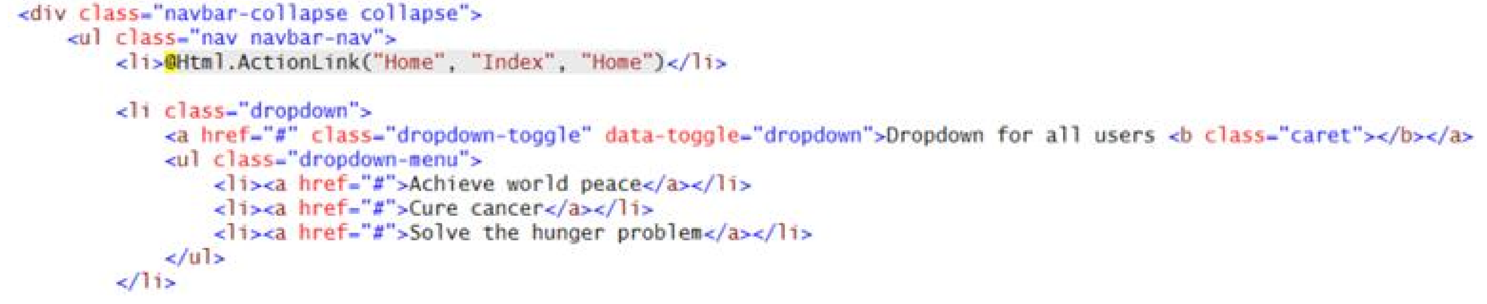
Dropdown Menu Code Example

Slide 5
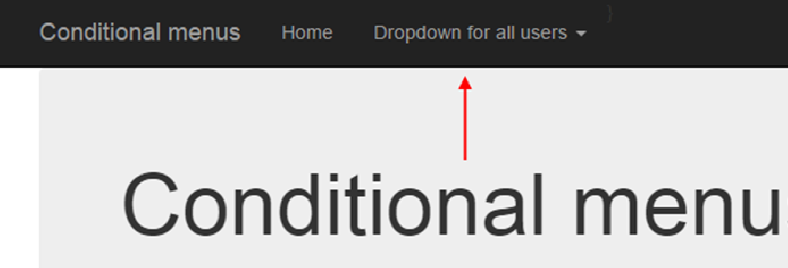
Dropdown Menu Render Example

Slide 6
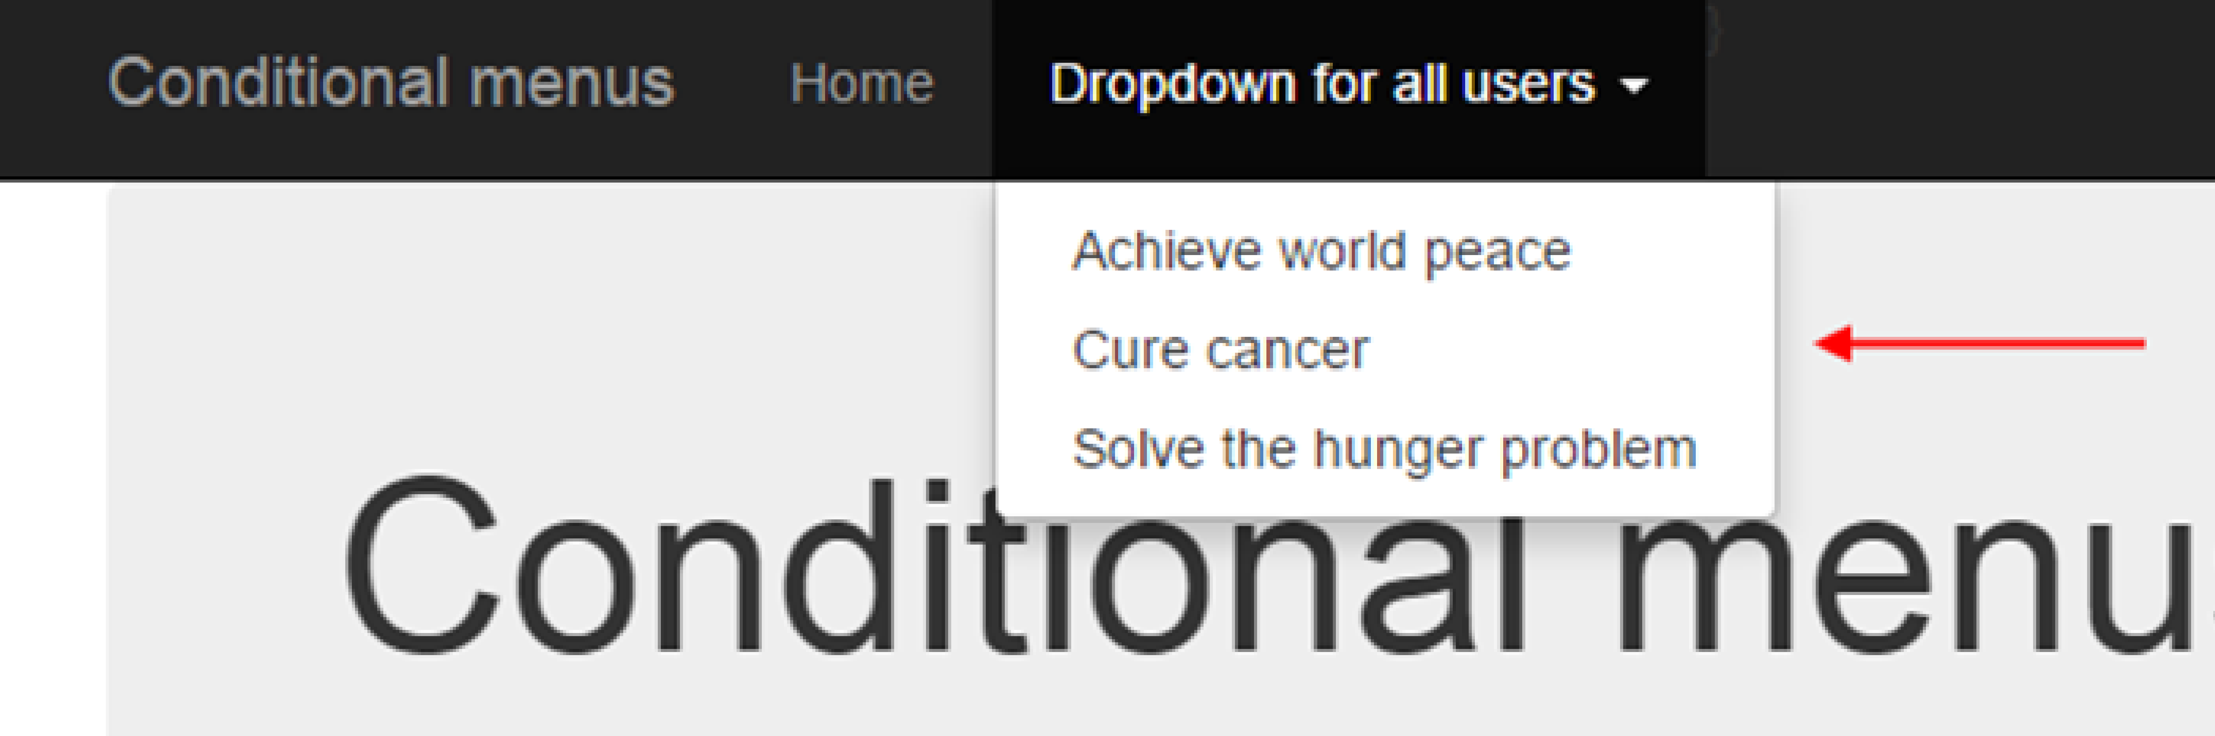
Dropdown Menu Render Example (Clicked)

Slide 7
Security

Slide 8
Conditional Menus Code Example
Open the ConditionalMenus code example and follow along.
Open the Manager.cs source code file. Near the bottom, it has a new class named RequestUser.
This class makes it easy to expose often-used data in a user account.
Sometimes you need the data to make a decision (e.g. does the user have the “Admin” role claim?)
Sometimes you need the data for the user interface (e.g. the given name(s) and surname)

Slide 9
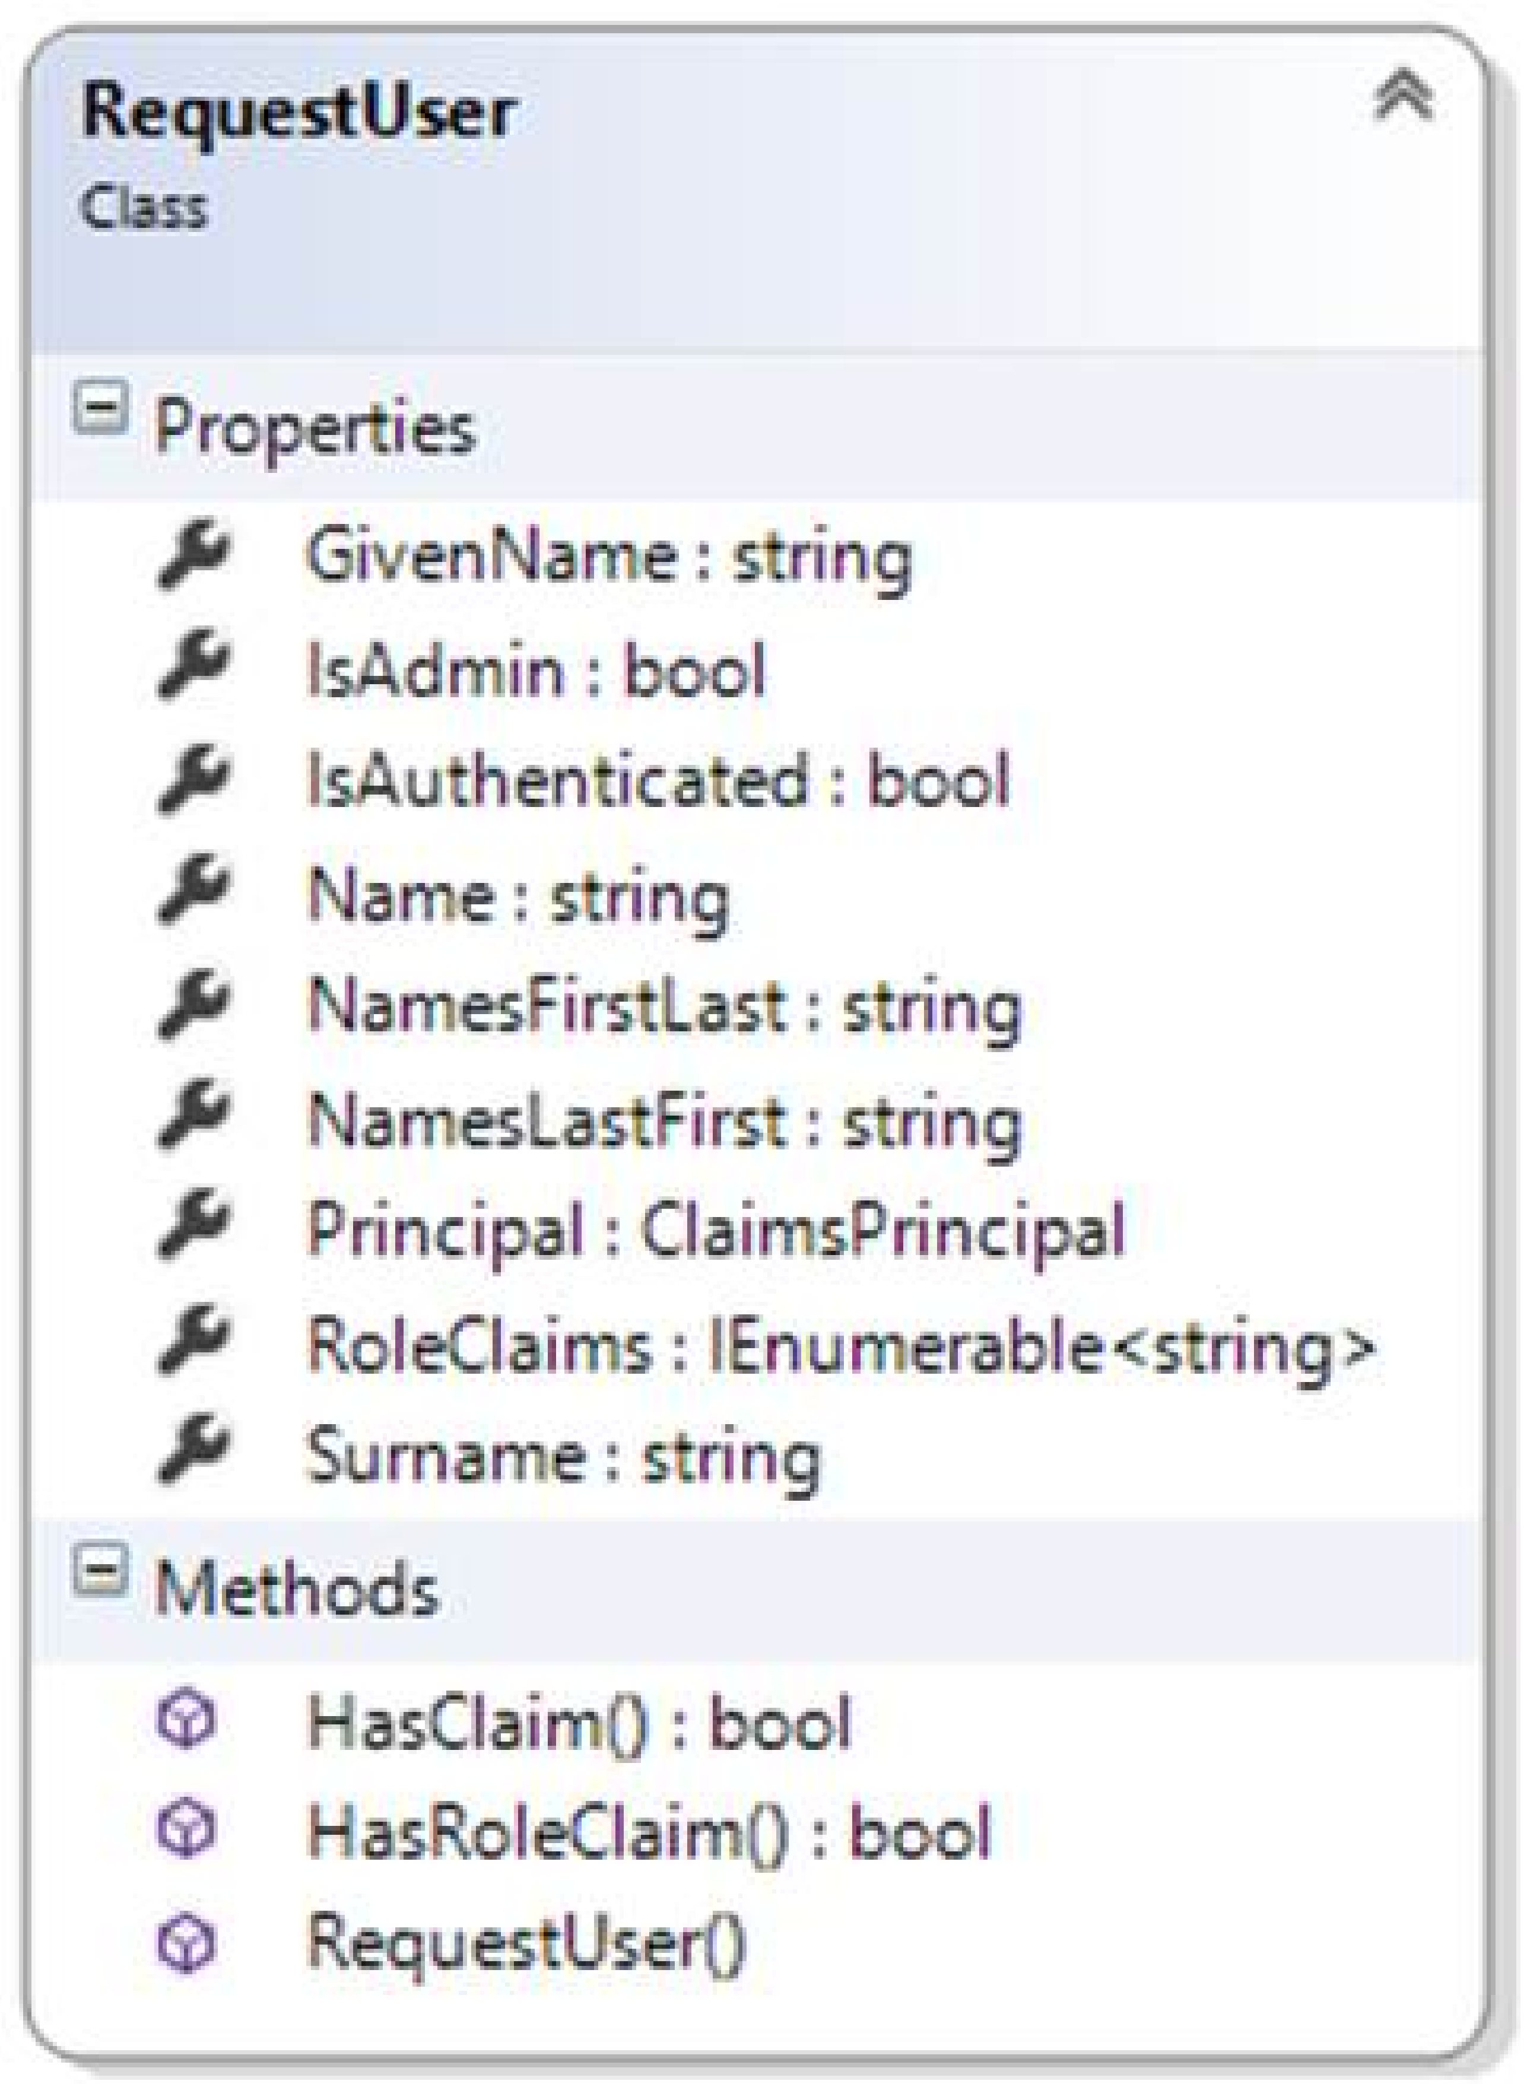
Information about the Authenticated User
We can use the RequestUser class to expose information about the current authenticated user.

Slide 10
RequestUser
This class makes it easier to get to often-used data.
It is a convenience class.
The Manager constructor creates one of these RequestUser objects and exposes it as a public property.
As stated in the comments, you can use this property in the Manager class methods to control logic and flow and to use its data/string content.

Slide 11
RequestUser in Controllers and Views
In a controller, you can use the property as follows:
var userName = m.User.Name;
In a view, you can use the property as follows:
For best results, insert it near the top of the view (inside the typically existing @ { } code block)
var userAccount = new <namespace>.Controllers.RequestUser
(User as System.Security.Claims.ClaimsPrincipal);

Slide 12
Conditional menu items (and dropdowns)
As you know, the _Layout.cshtml asset is used to render the default layout for views in your app.
It includes a menu.
The Bootstrap framework defines the appearance and behaviour of the menu.
We can add conditional menu choices to the menu.
A popular condition is “security”. In other words, if a user is logged in or contains a specific role claim, you may want to show one or more menu items.

Slide 13
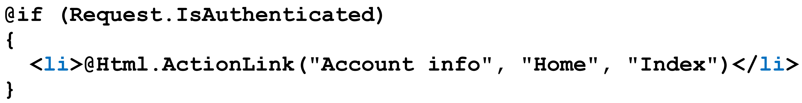
Conditional menu items (with RequestUser)
You just learned about the new RequestUser object.
You also learned that you can retrieve the object in a view.
Its properties (and methods) can be used to make decisions about what to render.
For example, you can render a menu item if the request is authenticated. You may either use Request.IsAuthenticated or userAccount.IsAuthenticated.

Slide 14
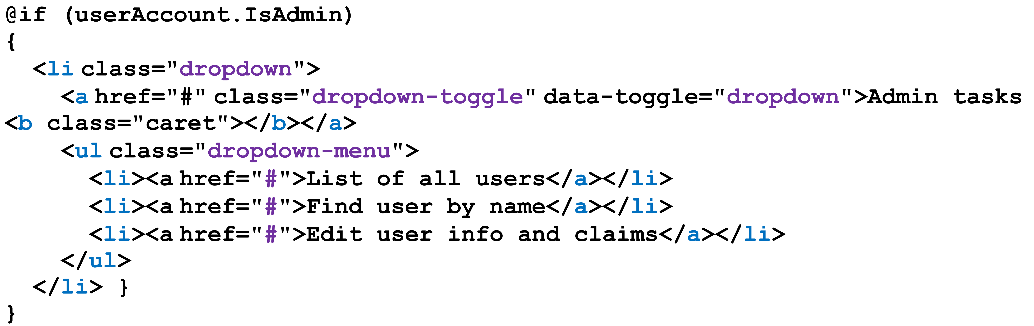
Render a Menu Example
You can also render a menu item (or a full dropdown menu) if the authenticated user has the “Admin” role claim.

Slide 15
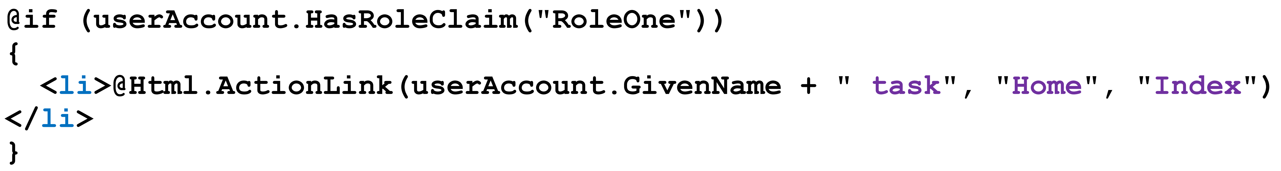
Render a Menu Item Example
You can render a menu item based on any other logic or condition.
You can even render strings from the RequestUser object in the menu itself.

Slide 16
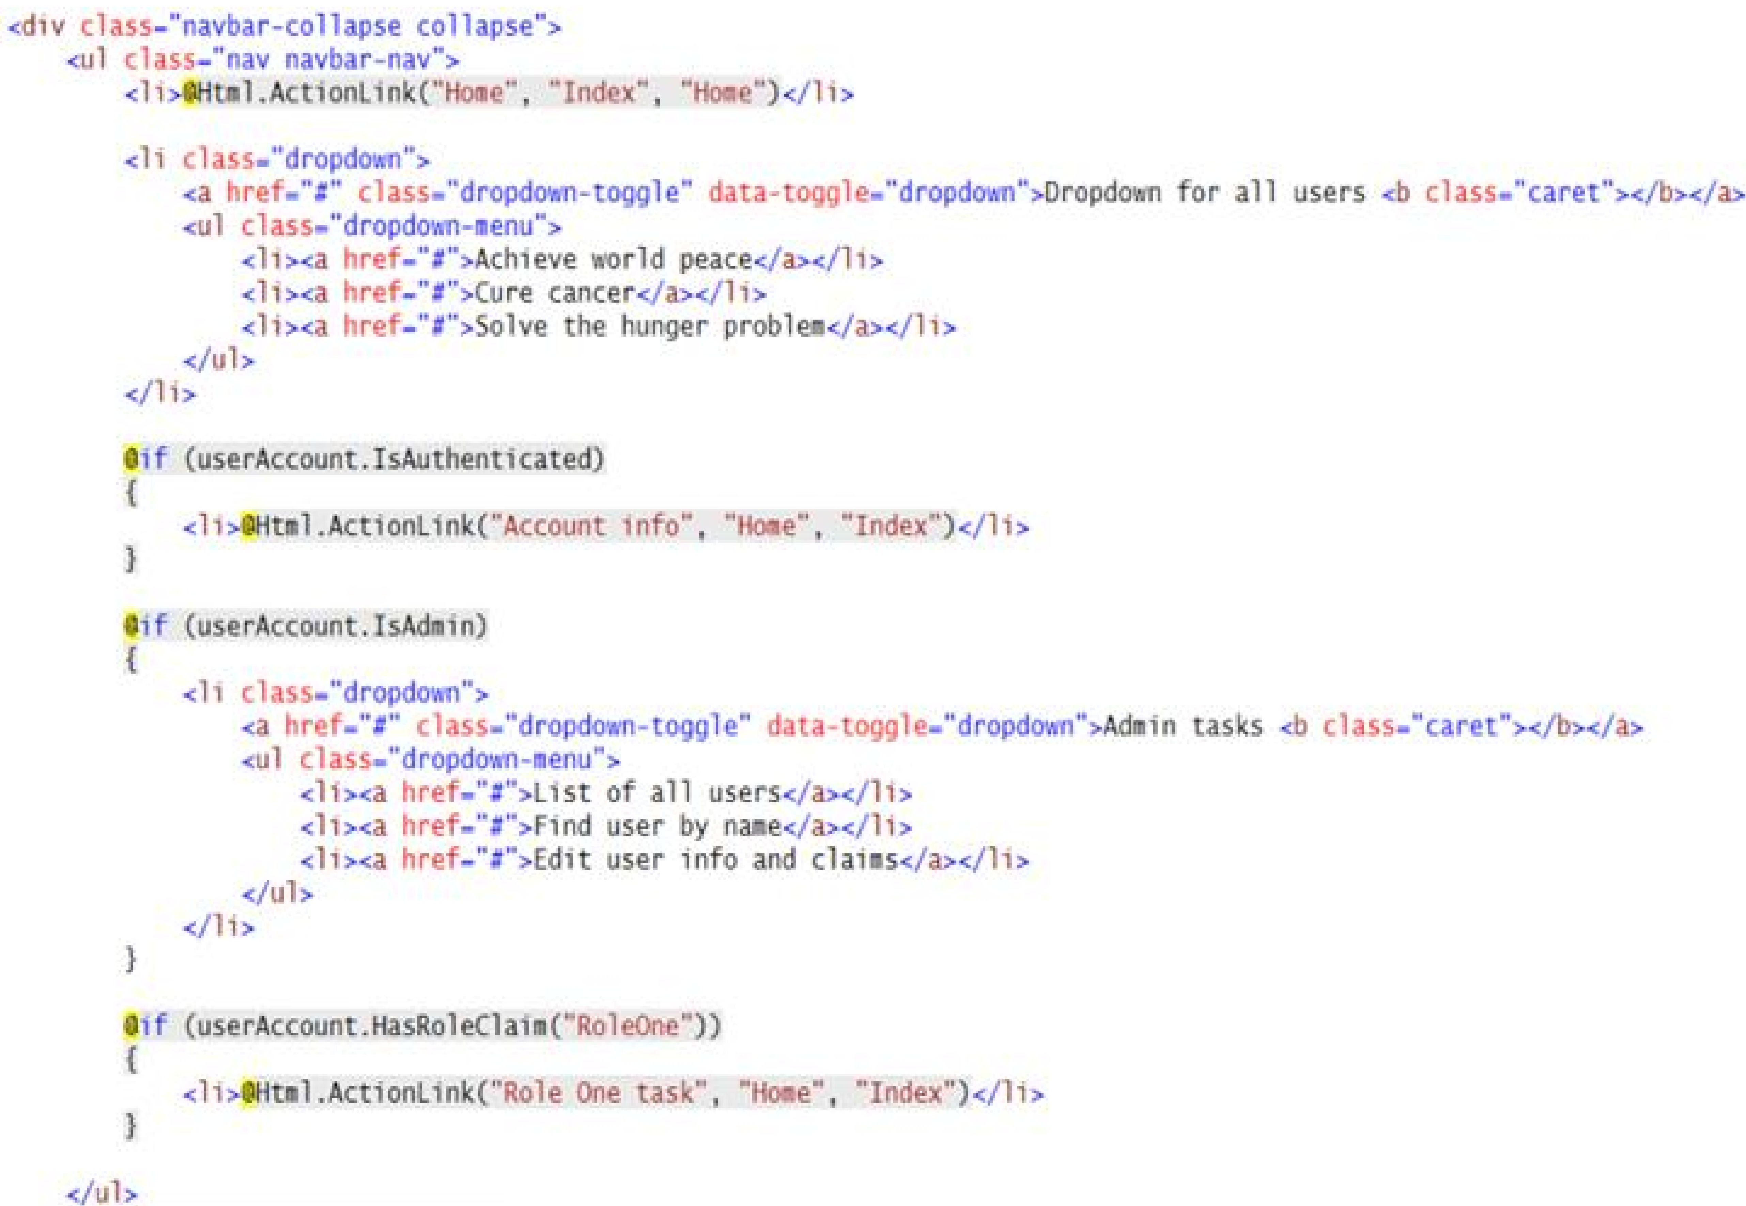

Slide 17
User account management
If you remember, the ASP.NET Identity system does not include a ready-to-use tool to manage user accounts.
Open the ManageAccounts code example and follow along as we discuss this section.
In the past, while you studied the Account and Manage controllers, you probably noticed the UserManager object.

Slide 18
UserManager Object
It is part of the in-memory security components available while your app is running. It enables:
a Users property (containing all users)
Find methods, to locate a user by name or other search term
an AddClaim method to add a claim of any type
the ability to Delete a user
… and many other members to help you work with your app’s users.
The code example includes an AccountManager controller, and some views. Run the app, create some users, and use the account management features. Study the code.

Slide 19
Restrict viewing and editing to the owner of an object
This is a common scenario, in all web apps (and web services).
Study the NotesApp code example while we discuss this section.
Almost all web apps enable users to work with public data and data that is private to the logged-in user.
For example, all the web/mobile apps that you already use implement this scenario: Messages, Mail, Instagram, Facebook, Twitter, etc.
The methods in the Manager class are the key to implementing this behaviour.
They rely on entities that include user account identity/information in their schema.

Slide 20
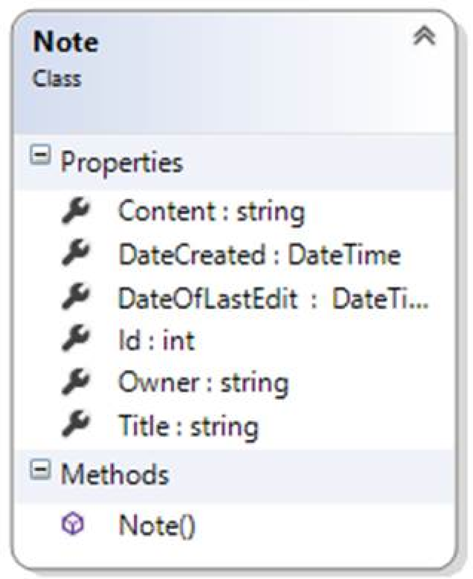
NotesApp Code Example
There’s a Note class with an Owner property.
The value of the Owner property is set when the object is created.
Whenever we need to access the object, we must provide user account information.
For example, in the “get one” note method in the Manager class, we perform the check: var o = ds.Notes.SingleOrDefault (n => n.Id == id && n.Owner == User.Name);

Slide 21
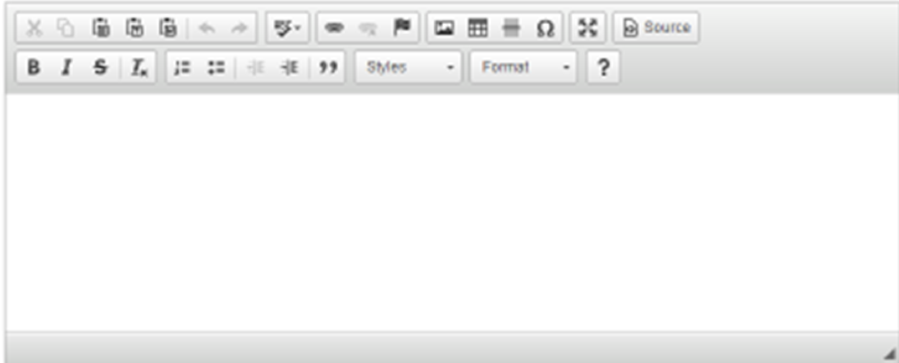
Rich text editing
CKEditor is a JavaScript component that replaces an HTML <textarea> element with a nice-looking and highly functional rich text editor.
Review the RichTextNotesApp code example.

Slide 22
How to use CKEditor
The editor works with string properties in a view model class.
For best results, add the [DataType(DataType.MultiLineText)] to a string property (in a “…Form” view model class). At runtime, the Razor view engine will render it as an HTML <textarea> element in a Create or Edit view.
Near the top of the view – maybe below the @ { } code block – add a reference to CKEditor. For best results, get it from its content delivery network: <script src="//cdn.ckeditor.com/4.5.7/standard/ckeditor.js"></script>
Convert the HTML <textarea> element into an editor: <script>CKEDITOR.replace('Content', { startupFocus: true });</script>
The code above assumes that the HTML <textarea> element has a name attribute with a value of “Content”.

Slide 23
Controller method to handle the Form post
For security purposes, the ASP.NET runtime prevents HTML markup or script code from being posted to a controller method.
In this situation, we know that the rich text editor will include HTML code and we want to allow postback of it’s content.
We have to add this attribute to the controller method that handles the HTML Form post: [ValidateInput(false)]

Slide 24
Render rich text string properties in the user interface
Normally, string content is HTML encoded when it is displayed in a view (e.g. List, Details, Delete).
In this situation, we want rich text string content to be displayed as-is.
We must render it with a different HTML Helper.
Assuming that the “Content” property is a rich text string, write this code: @Html.Raw(item.Content)

